Slide 1


McDowell EcoLabs
Champaign County Crash: Cause of Severity
Supanut Wanchai
wanchai2

Slide 2

Outline
Recap & Additional Statistic
Research Question & Data Modelling
Severe Crash vs. Traffic Crime
Bike Severe Crash - Distance
Pedestrian Severe Crash - Light
Conclusion

Slide 3
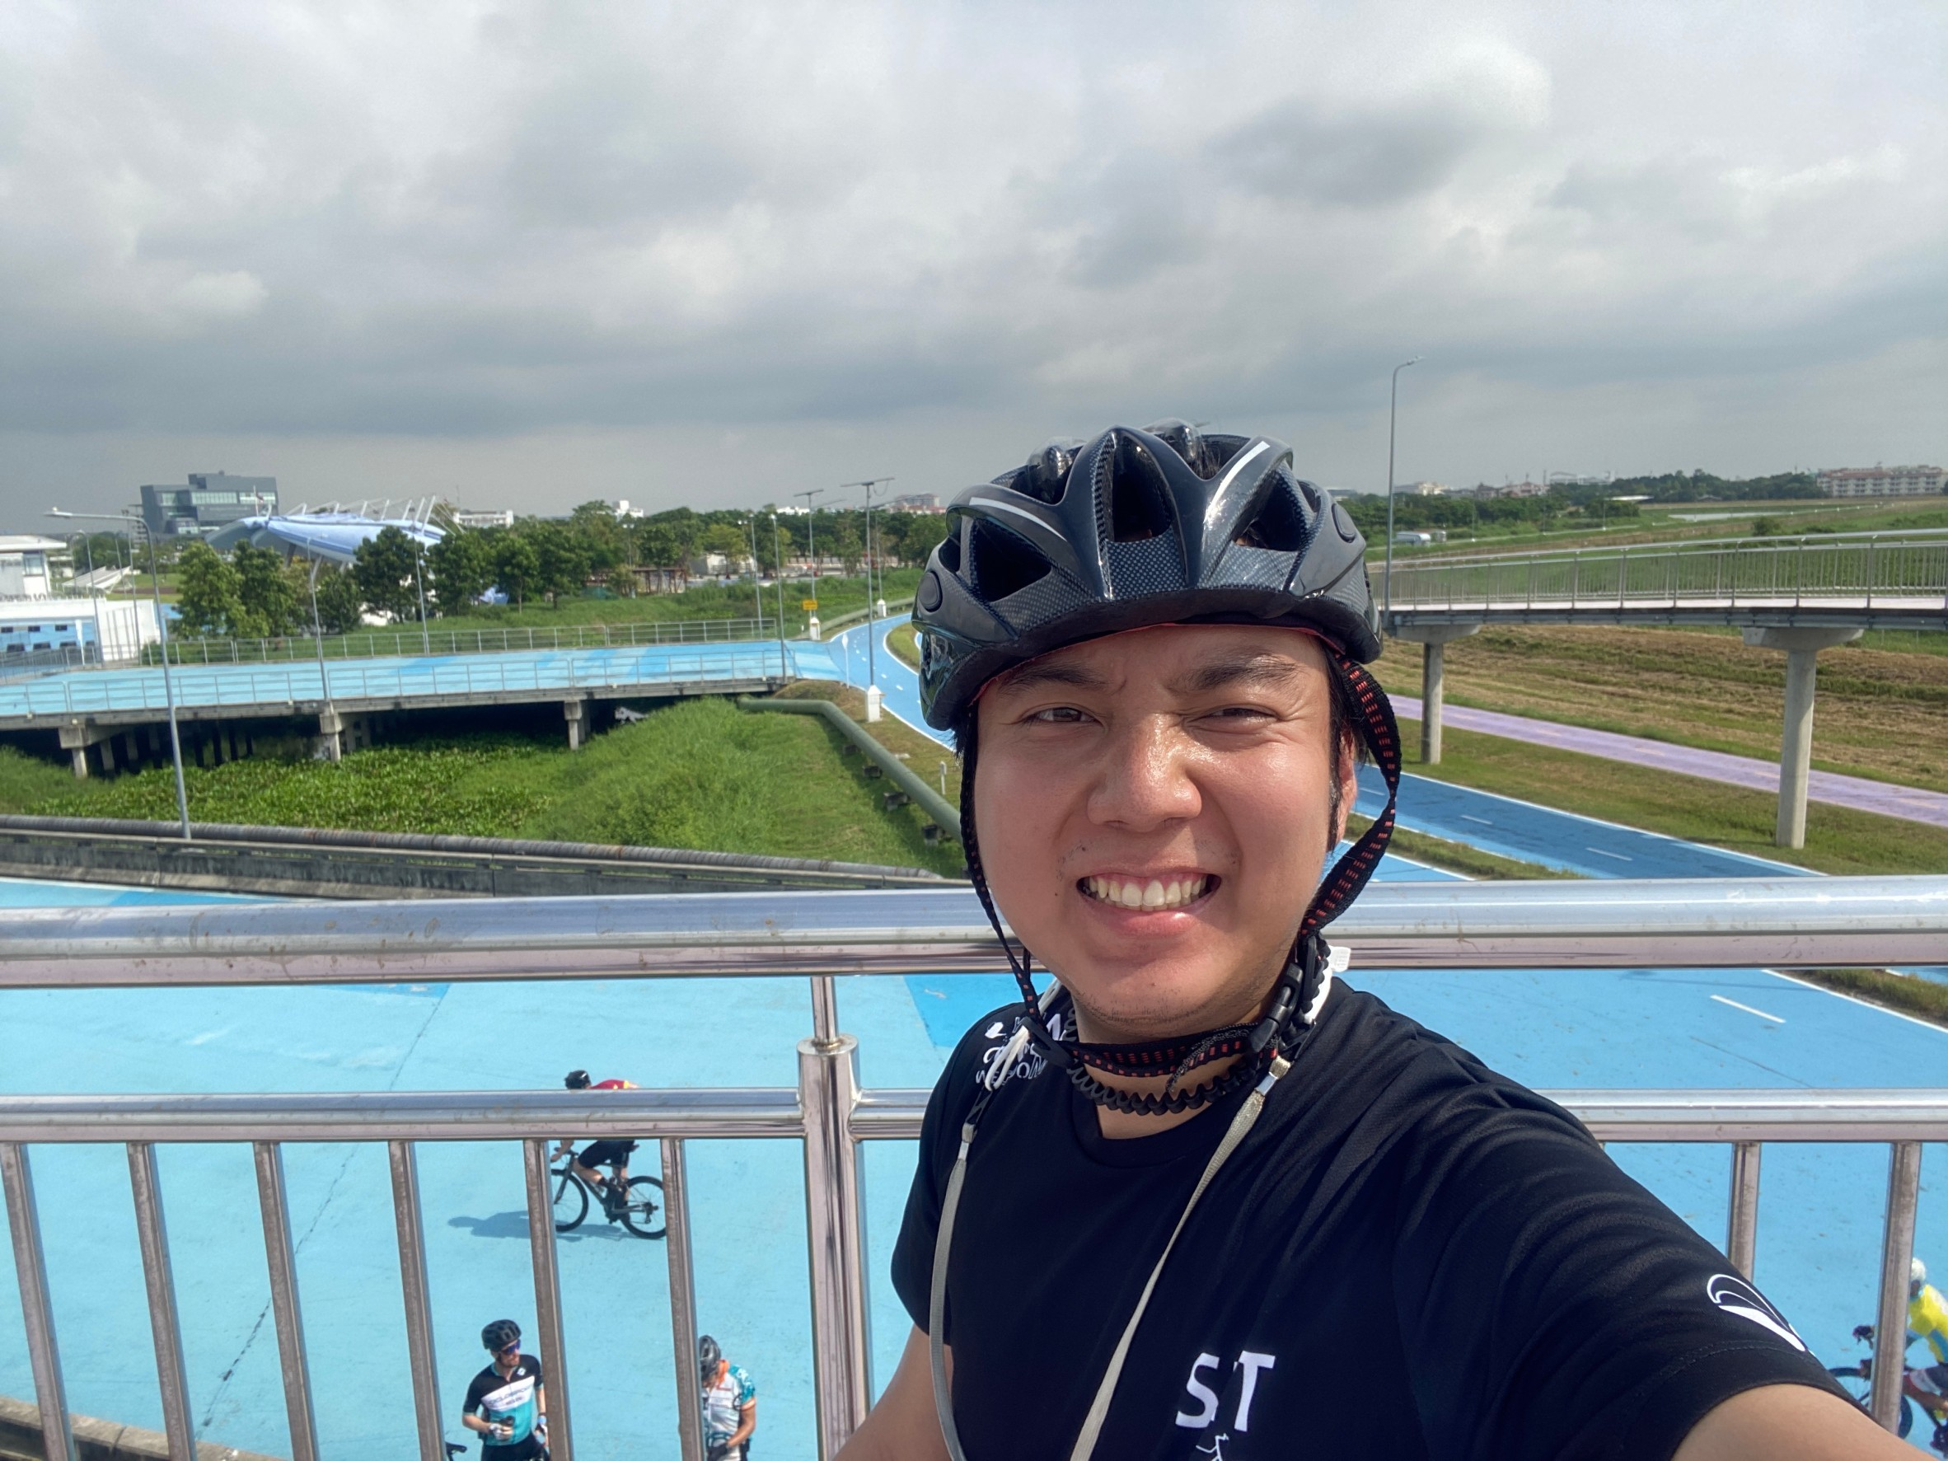
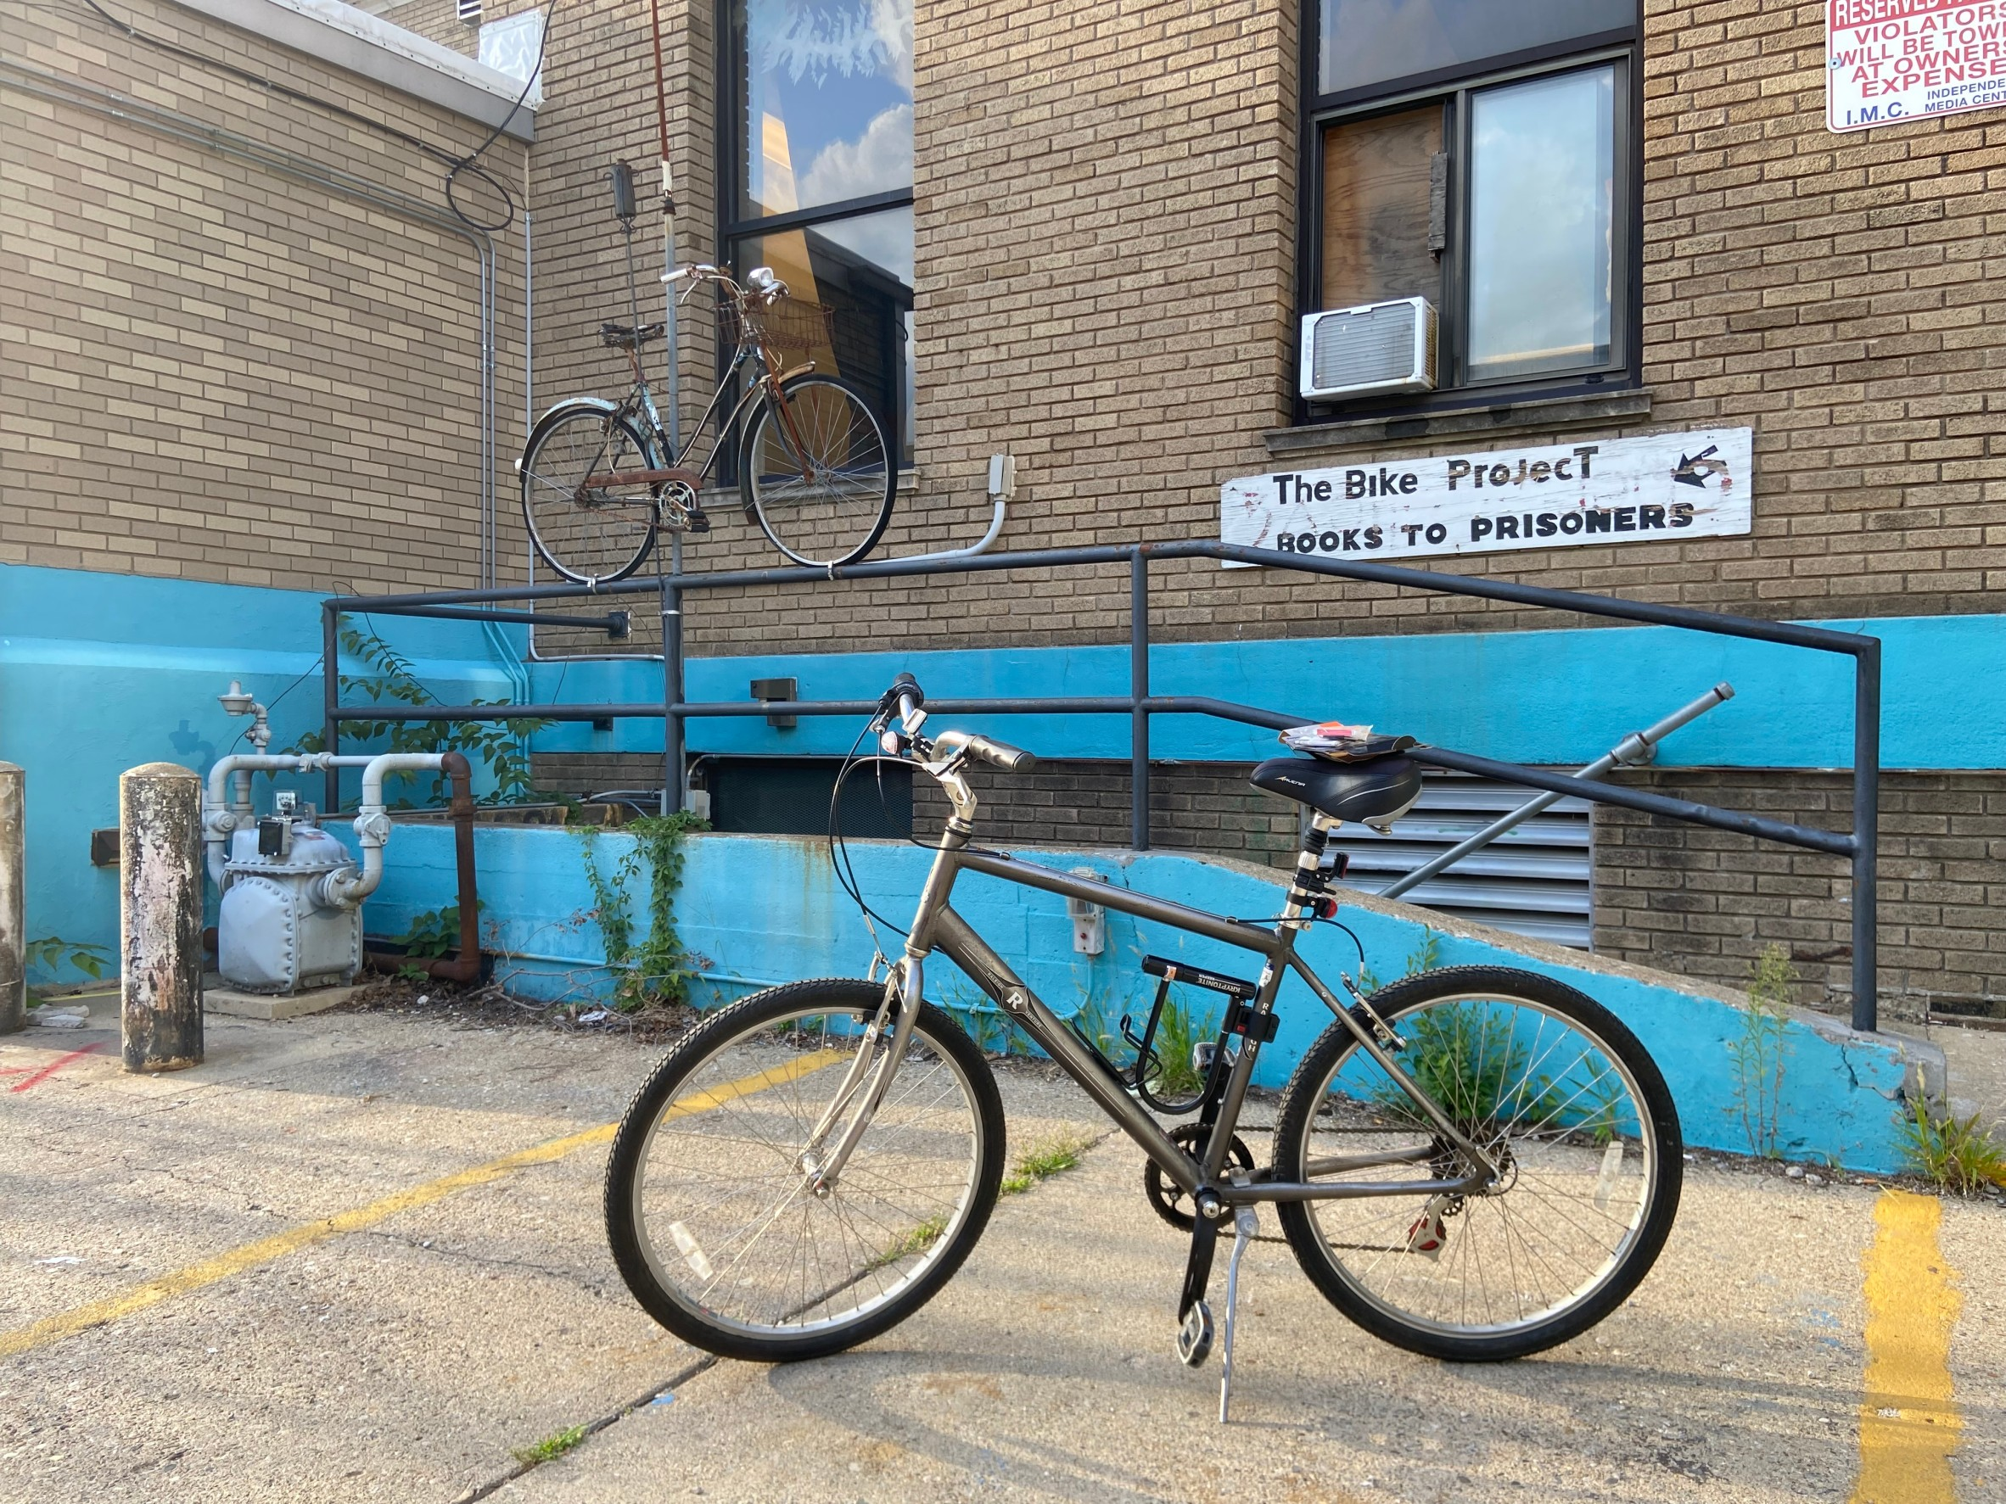
Motivation

Slide 4
Data Preprocessing
Bike Data from 1999-2020
Highlight Variables
911 rows --exclude before 2005 -> 896 rows
-- exclude Unknown -> 833 rows
Severity
Weather
Light
Road Surface
Traffic Control
City
Pedestrian Data from 1999-2020
825 rows --exclude before 2005 -> 799 rows
-- exclude Unknown -> 743 rows

Slide 5
Data Grouping
 | Severity
Severe | Fatal, A-Injury
Non-Severe | B-Injury, C-Injury, No Injuries, Property Damage
 | Weather | Light | Road Surface | Traffic Control | City
Good Condition/ City Area | Clear | Daylight, Lighted Road | Dry | Any Control | Any City
Bad Condition/ Unincorporated Area | Cloudy/Outcast, Fog/Smoke/Haze, Rain, Snow | Dawn, Dusk, Darkness | Ice, Sand/Mud/Dirt, Snow or Slush, Wet, Other | No Control | Unincorporated

Slide 6
Recap: Factors affect severe crash
Bike Crash
Pedestrian Crash
City | Severe | Non-Severe
Unincorporated | 21 | 35
City Area | 165 | 612
Odds Ratio/ 95% CI | 2.22 | [1.19, 4.05]
Light | Severe | Non-Severe
Bad | 62 | 74
Good | 210 | 397
Odds Ratio/ 95% CI | 1.58 | [1.07, 2.35]
Does unincorporated area really affect crash severity?
If not, what does?

Slide 7
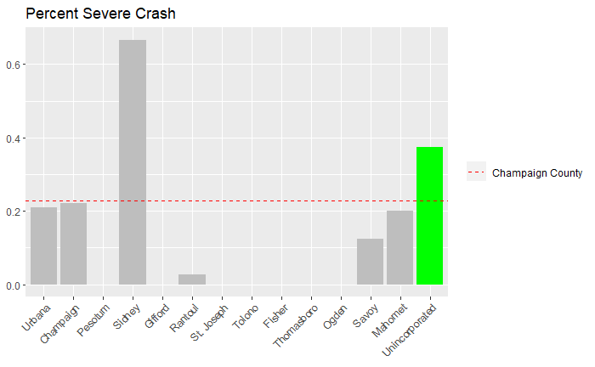
Percentage of Severe Bike Crash
Data: 2005 – 2020
Sidney is outlier. There are 3 crashes and 2 of them are severe.

Slide 8
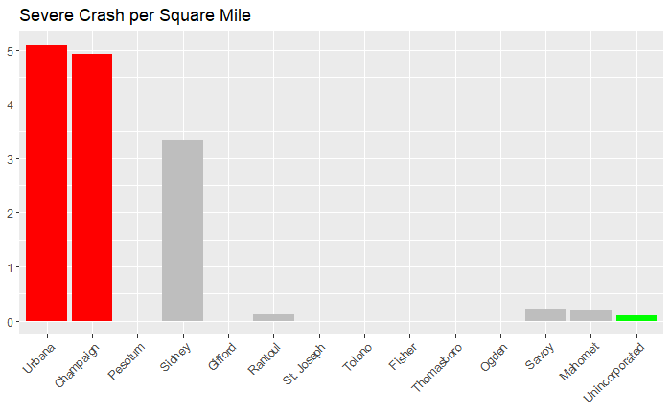
Severe Bike Crash Per Sq Mile
City | Sq Mile
Champaign | 22.5
Urbana | 10.8
Unincorporated Area | 215.2
Data: 2005 – 2020

Slide 9
1. Severe Crash vs. Traffic Crime
Top 10 Traffic Crimes
Ideal Regression Line
2005 – 2020
Focus only on Urbana Crash
16 Observations by year (2005 – 2020) – Count of each variable in each year.
Severe ~ SPEED + TF_SIGN + VOICE_COMMU + LICENSE + LANE + LIGHT + BELT + POPULATION
Mean Severe Crash: 3.44
Variance: 6.66
Group | Crime Description
SPEED | Speeding (RADAR), Failure to Reduce Speed
TF_SIGN | Traffic Sign Violation
VOICE_COMMU | Electronic Communication-Voice
LICENSE | Operate Uninsured Motor Vehicle, No Valid DL Drivers License
LANE | Improper Lane Usage
LIGHT | Driving Without Light, Improper Lighting/One Headlight
BELT | Seat Belt-Driver & Passenger

Slide 10
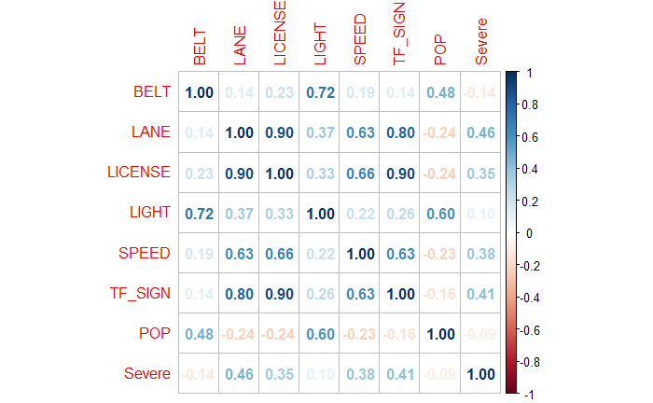
1. Severe Crash vs. Traffic Crime
Check Multicollinearity
Initial Regression Line
Correlation Matrix
Severe ~ SPEED + LANE + LIGHT + BELT + POPULATION
Remove VOICE_COMMU because it started in 2014
Remove TF_SIGN and LICENSE because they have high correlation with LANE
No significant predictor
Adjusted R Square: -0.03
RMSE: 2.06

Slide 11
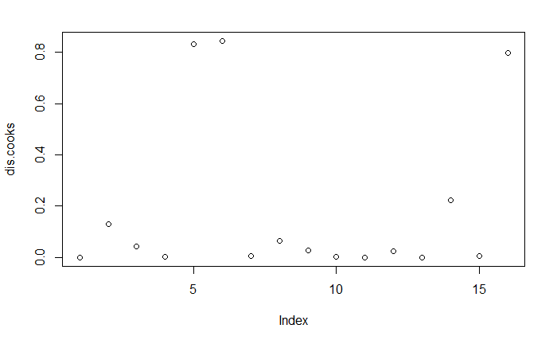
1. Severe Crash vs. Traffic Crime
Influential Observations
Backward Selection
No Influential (cook’s distance > 1)
Severe ~ LANE
Intercept: -2.79 (insignificant)
Beta_Lane : 0.03, P-value: 0.07
R Square: 0.21
Adjusted R Square: 0.16
RMSE: 2.21

Slide 12
2. Bike Severe Crash - Distance
Detail
Result
Distance: from Green & Wright in Km.
City: only Champaign & Urbana
Do not check multicollinearity because there are categorical variables
Logistic Regression
Severe ~ dist_km + light_group + weather_group + surface_group + traffic_group
Group | Coefficient | P > (Chi)
Intercept | -1.70
dist_km | 0.08 | 0.12
light_group | 0.12 | 0.89
weather_group | -0.12 | 0.61
surface_group | 0.37 | 0.26
traffic_group | 0.34 | 0.06
No significant variable
Adjusted R Square: 0.006

Slide 13
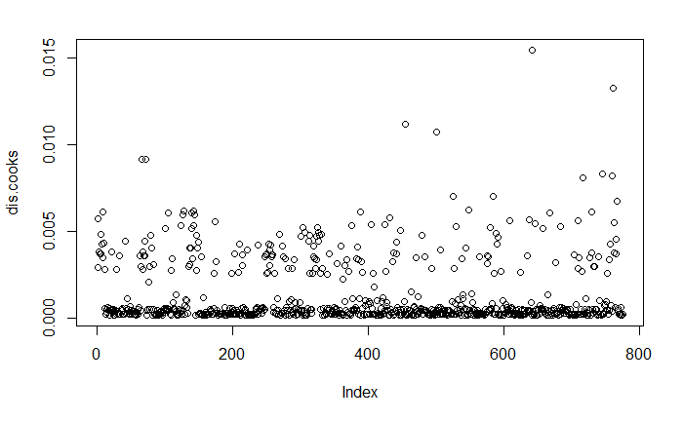
2. Bike Severe Crash - Distance
Influential Observations
Backward Selection
No Influential (cook’s distance > 1)
Group | Coefficient | P > (Chi)
Intercept | -1.55
dist_km | 0.09 | 0.12
traffic_group | 0.34 | 0.05
AUC: 0.5
Adjusted R Square: 0.006
Predicted/ Actual | Non-Severe | Severe
Non-Severe | 598 | 177
Severe | - | -
Distance in term of On Campus/Off Campus does not work as well

Slide 14
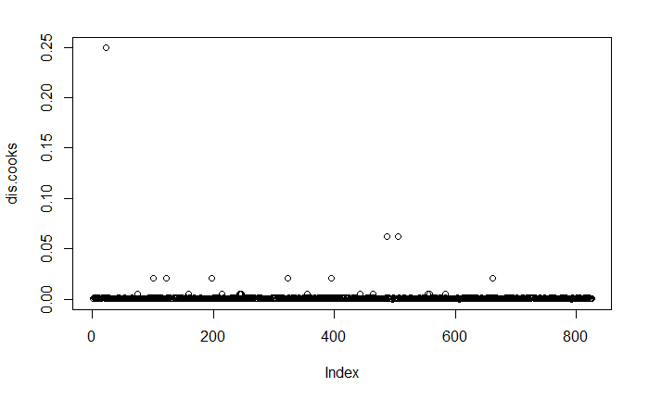
3. Pedestrian Severe Crash - Light
Detail
Influential Observation
Logistic Regression
Do not check multicollinearity in categorical variables
5 Light Categories: Darkness, Dawn, Daylight, Dusk, Lighted Road, Unknown
Severe ~ Light
No Influential (cook’s distance > 1)

Slide 15
3. Pedestrian Severe Crash - Light
Forward Selection
Tukey Pairwise Test
Severe ~ Light
AUC: 0.54
Adjusted R Square: 0.007
Misclassification: 0.38
Pairwise | Diff | P - Value
Daylight - Darkness | -0.14 | 0.032
Lighted Road - Darkness | -0.16 | 0.052
Other |  | 0>0.4
Predicted/ Actual | Non-Severe | Severe
Non-Severe | 448 | 249
Severe | 63 | 65

Slide 16

Summary
What’s next?
Bike and Pedestrian Crash could be predicted well by variables given in this data set.
Daylight and Lighted Road have less possibility of severe crash than Darkness at 5% and 10% significant level. But we cannot conclude statistically about Dusk, Dawn and Unknown.
Find other way to utilize location variable.
Find other dataset to help predict severity crash.

Slide 17
Thank you for listening

